Slide 1
INTRODUCTION
The manual work of result analysing takes a tedious turn when a large number of records are to be analysed upon.So,in order to reduce the manual process of documentation and analysing this project has been developed. We aimed at creating an analysing method which erases the need of removing conclusions manually.
We have considered university result pdf file for the academic year 2017-2018(SE COMPUTER) for the analysis.We analysed various parameters from result analysis of the university result pdf file (which is in the form of excel sheet).This project categorises the result distinction wise and also finds fail result percentage.

Slide 2
PROBLEM STATEMENT
To analyse various contents from university result ,in order to see that the manual process of deriving conclusions is reduced using automated programs. This analysis is being done with the help of 2 languages and that are Python and R.
Data which is analysed helps to:
1. Compare online and theory result
2. Maximum and minimum result
3. Visualization of grades
4. Comparison of results division wise
5. Failed result percentage
6. Comparison of result semester wise

Slide 3
OBJECTIVES
The main objective of the project is to build an application program that provides a platform to reduce the manual work for analysis the result of students.
2. To conclude what is the performance of students in a subject.
3. To generate subject wise result in percentage.
4. To show result based on different categories.
5. To show the list of failed student.
6. To conclude which subject needs to be given more attention.

Slide 4
DATA AND REQUIREMENTS
Data
The data is taken from university result pdf file .The data is in the form of excel sheet which is later converted into CSV(Comma Separated Value) files
Requirements
Hardware Requirements
Dual core Intel or i3 processor
4 GB RAM
Memory Space
Software Requirements
1. Python Programming Language
2. R Programming Language

Slide 5
TOOLS AND TECHNIQUES
There are some tools and languages that are required while doing the analysis of the data and they are as follows:
1. matplotlib
2. numpy
3. csv
4.pandas
There are some techniques that have been used for the visualization of data and that are as follows:
1. Graphs
2. Bar Charts
3. Pie-charts
4. Histogram
6. Linear Regression

Slide 6
DATA PRE-PROCESSING
Identify missing values, blank spaces and special symbols in the given data, then put <NA> (Not Applicable) in the records where there are missing values and remove special symbols as well as blank spaces.

Slide 7
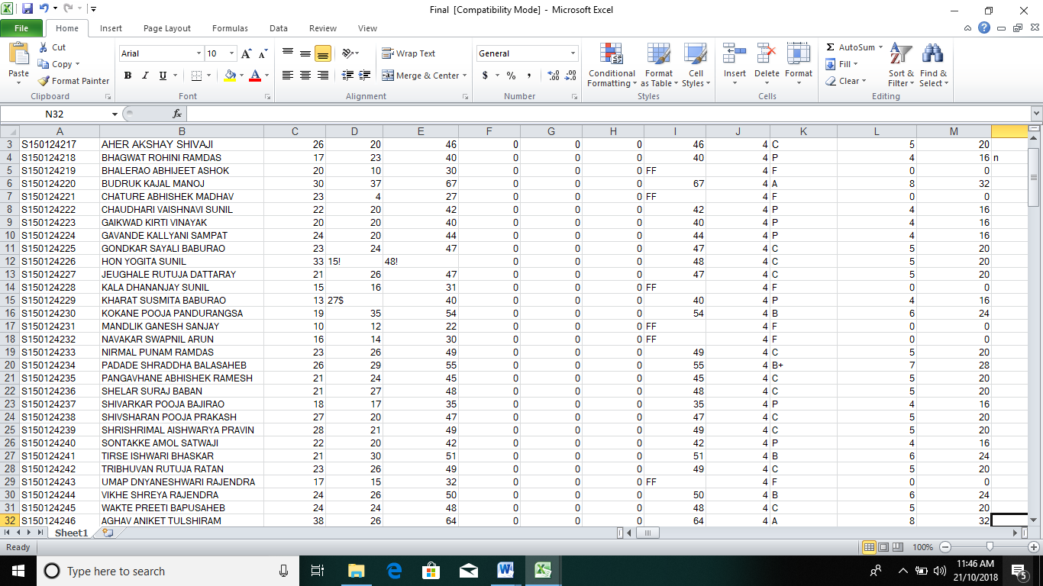
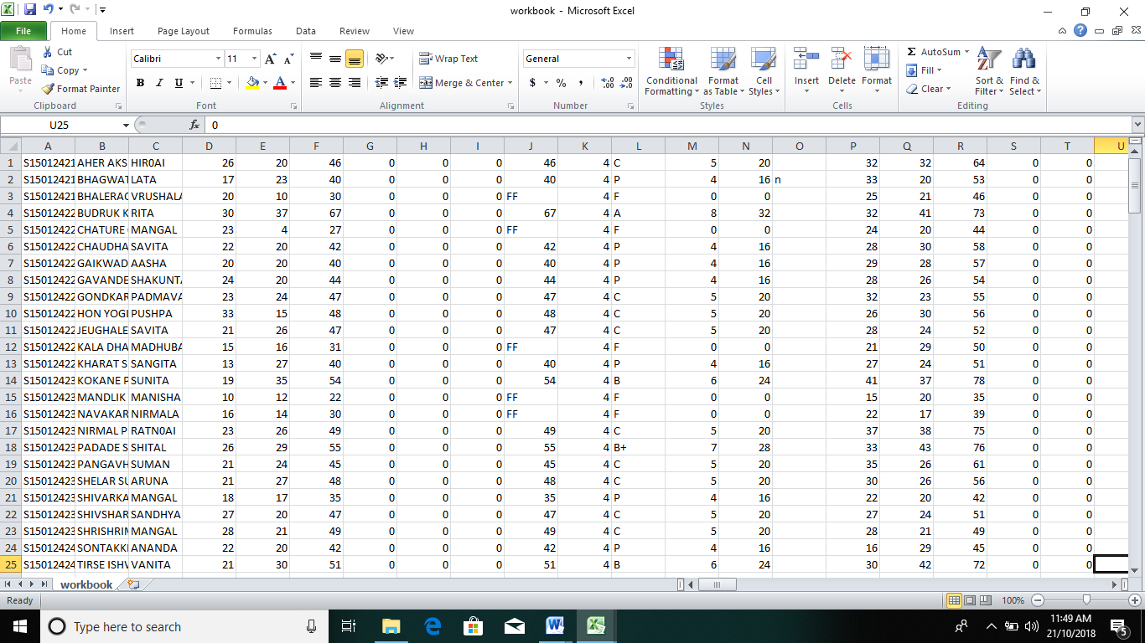
Data before pre-processing
Data after pre-processing

Slide 8
EXPLORATORY ANALYSIS
The data can be explored with the help of various functions like dim(), str(), summary(). We can see the structure of the data frame that we have created and we also can see the dimensions as well as the summary of the data frame. We can see the whole data frame using print() in R programming language.
Code(in R Language):-
df=read.csv("workbook1.csv",header=TRUE)
print(df)
dim(df)
str(df)
summary(df)

Slide 9
The function read.csv() will read the data in mentioned csv file and will create a data frame.
2. The function dim() will give the dimesions of the data frame.
3. The function str() will give the structure of data frame and will show whether the attributes in it are factor or numeric data types, it will identify if factor is applicable or not and if yes then it will show the factors those are recognized and will also give the count as well as it will assign numbers to the factors identified by alphabetical preceedences.
4. The function summary() will give the minimum, maximum, median value of each column(attribute).

Slide 10
VISUALIZATION
This part includes the actual representation(visualization) of data. The data is visualized using both R and Python programming languages.
The libraries that are used while displaying the data are as follows:
numpy
matplotlib.pyplot
The functions that are used while displaying data are as follows:
plt.xticks()
plt.text()
plt.plot()
plt.legend()
plt.pie()
plt.hist()
plt.bar()
plt.xlabel()
plt.ylabel()
plt.show()

Slide 11
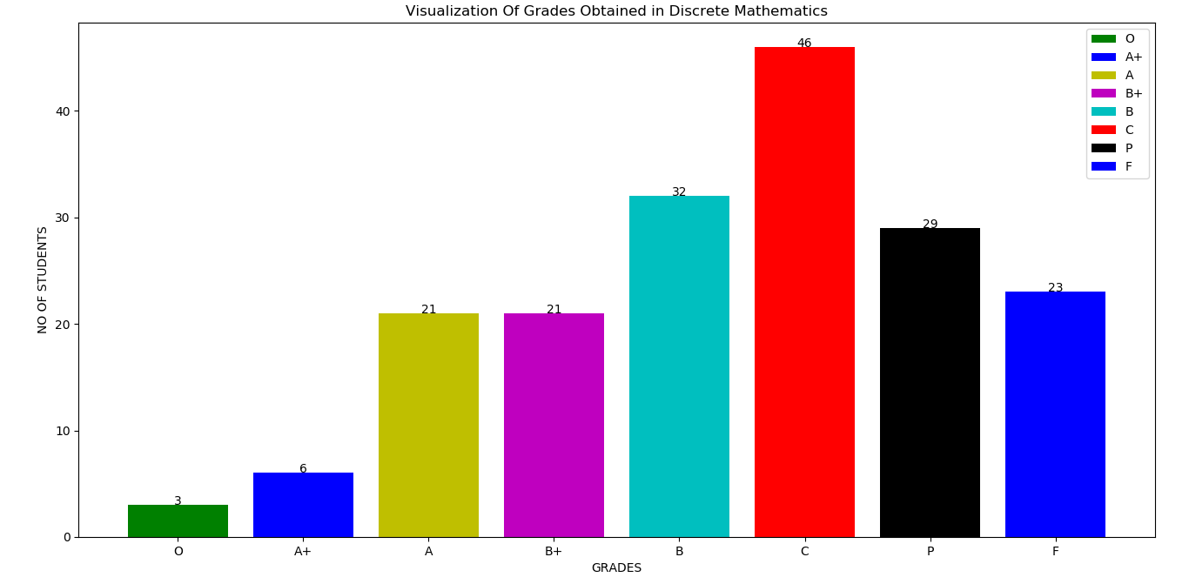
Fig. 1.1 Visualization of grades for the subject DM

Slide 12
In the above given graph we can clearly see out off 181 students;
1.The number of students getting C grade( i.e.in the range of ) is the most compared to others.
2.Students securing B grade are 32 which is the second highest.
3.Only 3 students have secured O grade(i.e above ).
4.23 students couldn’t clear this subject in the second attempt.
5.Number of students securing A and B+ are equal .

Slide 13
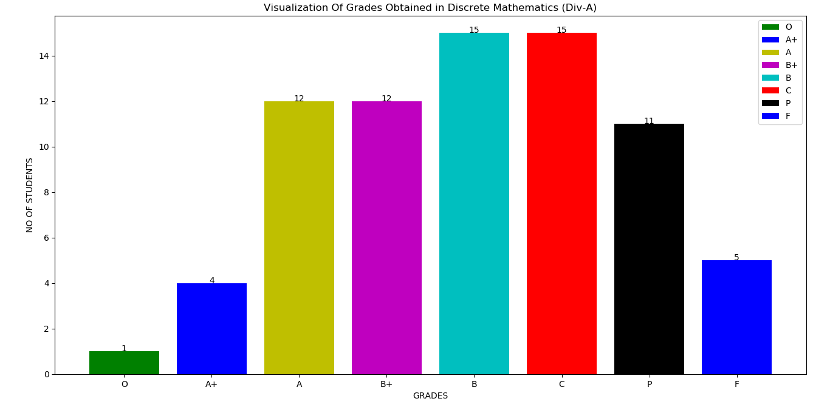
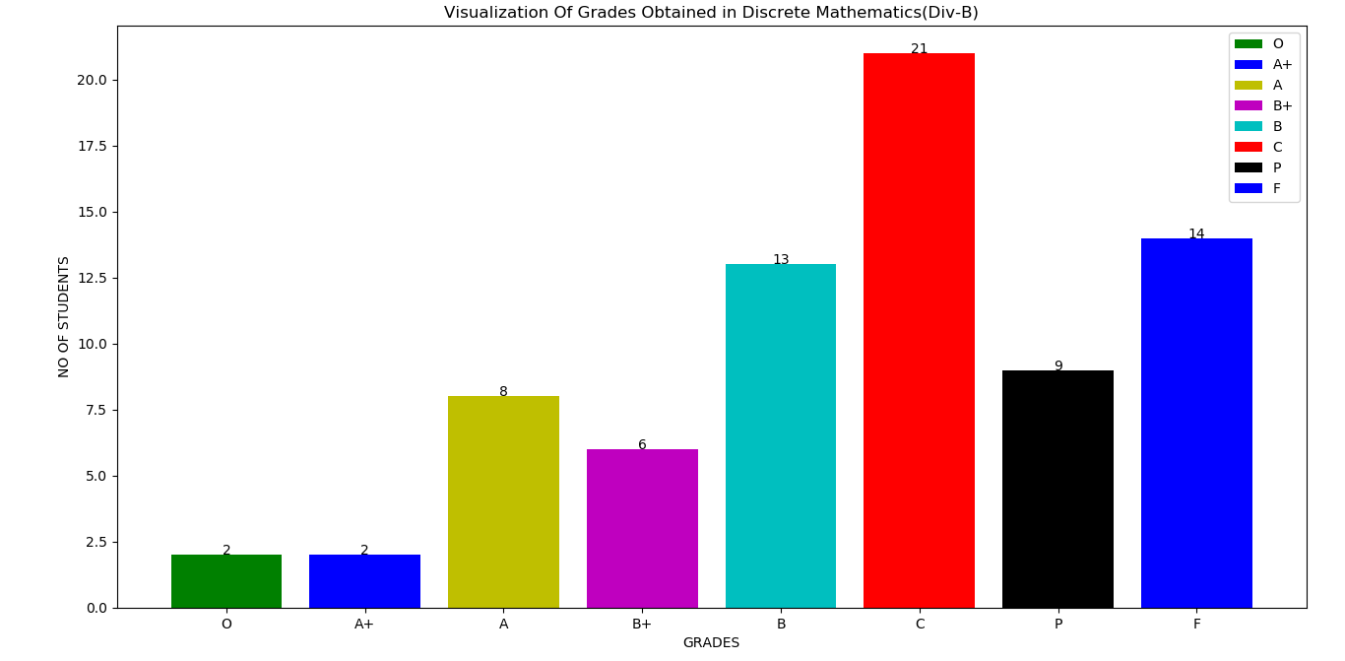

Slide 14
DIV –A
From the graph we can clearly see that only 2 students could secure an O grade whereas 4 students have secured A+ grade .The number of students securing A and B+ grades are equal(i.e.12 each),whereas the number of students securing B and C grade are equal(i.e.15 each).5 students couldnt clear this subject in the second attempt from div A.
DIV -B
From the graph we can clearly see that only 2 students could secure an O as well as A+ grade whereas only 8 students have secured A grade.21 students have got C grade which is the highest.14 students could not clear this subject.

Slide 15
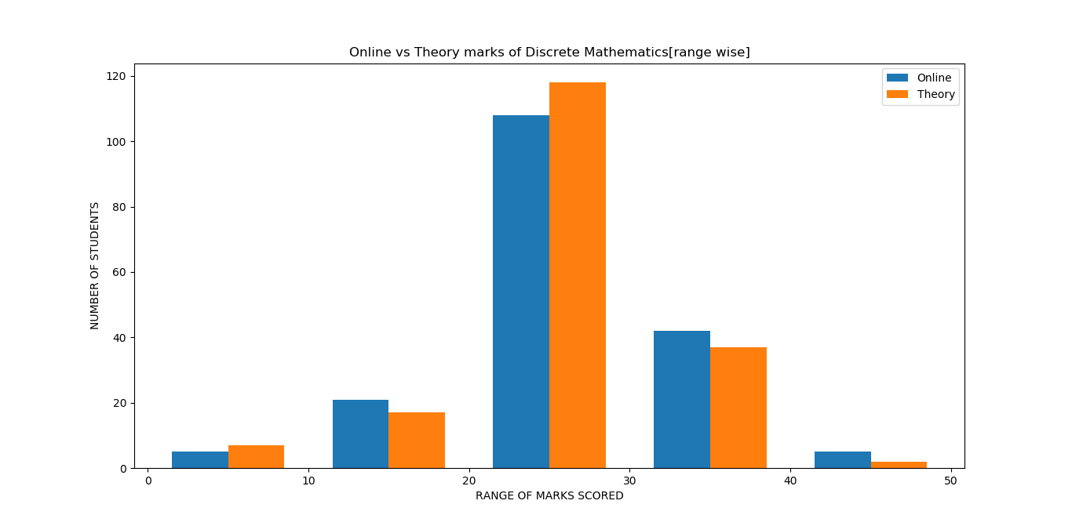
Online vs theory marks for DM
In the above graph we can clearly see that,most of students have secured marks in the range of 20-30 for both online as well as theory.In most of ranges the online marks beats the theory marks in case of scores,thus concluding that students get more in online compared to theory.Students securing marks in the range of 40-50 are the least for both online as well as theory.

Slide 16
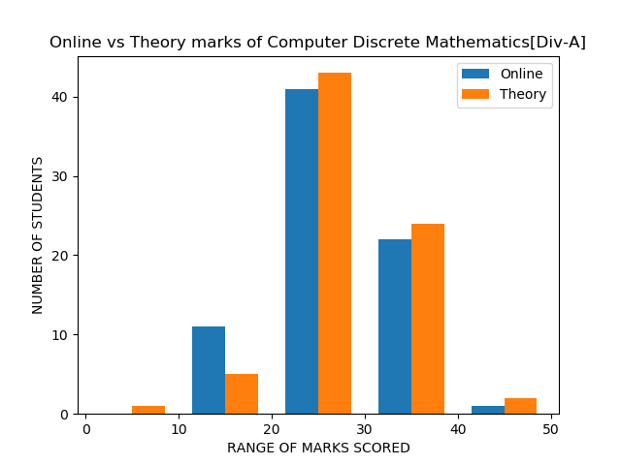
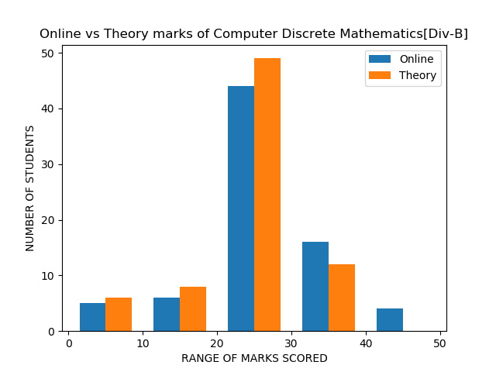
Online vs theory marks for DM

Slide 17
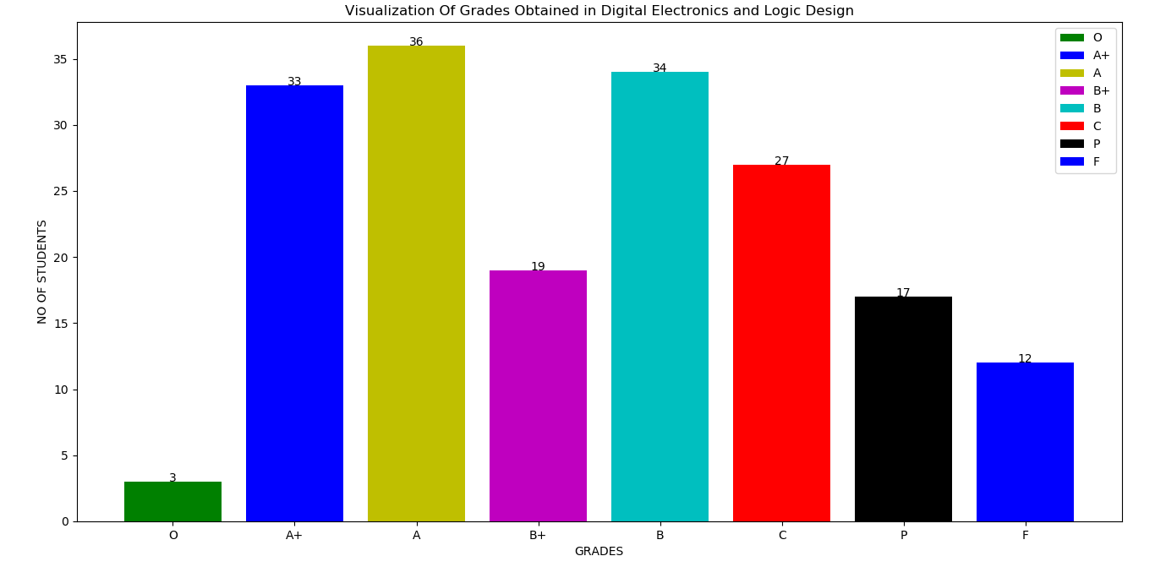
Visualization of grades for the subject DELD

Slide 18
In the above given graph we can clearly see outoff 181 students;
The number of students securing A+,A,B grades are nearly equal(i.e. 33,36,34 respectively)
Students securing O gradeis the least.
Only 3 students have secured O grade(i.e above ).
12 students couldn’t clear this subject in the second attempt.
The students securing B+ and C grades are almost equal .

Slide 19
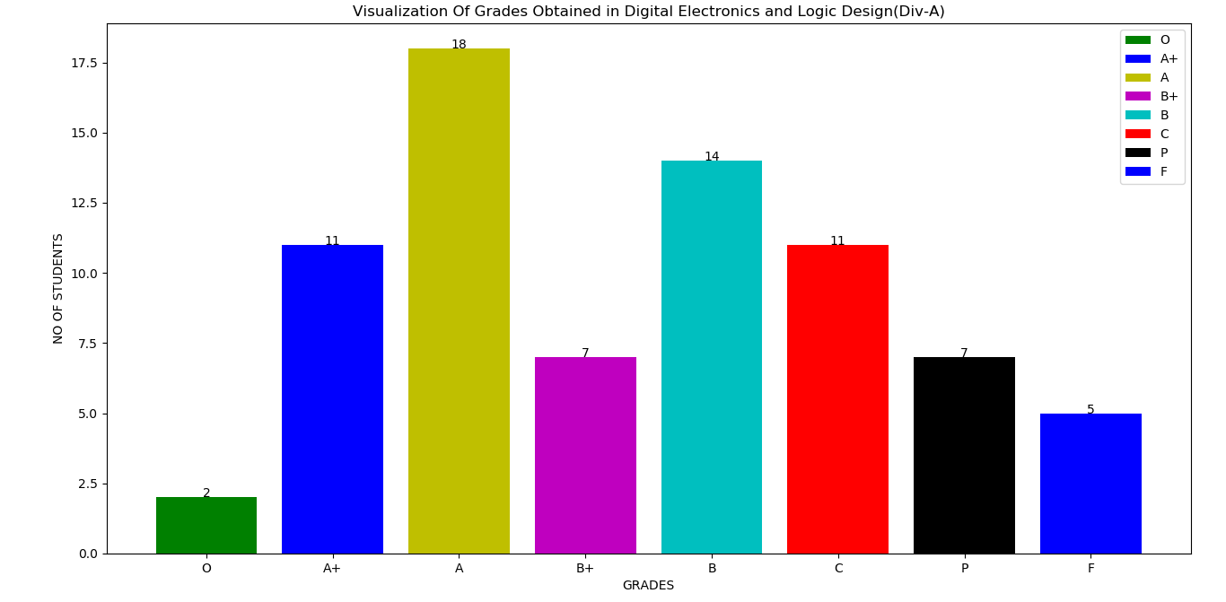
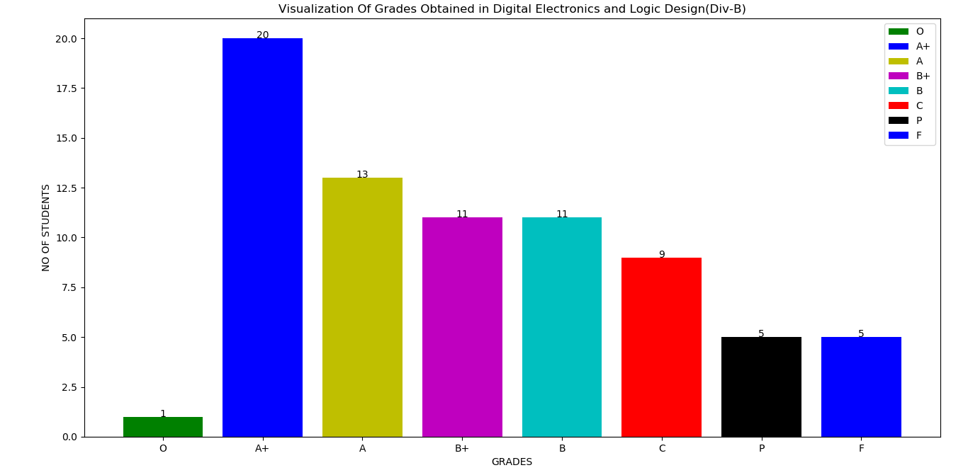
1b Visualization of grades for the subject DELD(div A)
Visualization of grades for the subject DELD(div B)

Slide 20
DIV-A
From the graph we can clearly see that,only 2 students could secure an O grade,whereas 11 students have secured A+ grade..5 students coudnt clear this subject in the second attempt from div A. Students securing A grade are 18 which is the highest.The number of students securing B+ and P grade are equal(i.e.7 each).
DIV-B
From the graph we can clearly see that,only 1 student could secure an O grade,whereas 20 students have secured A+ grade which is the highest.13 students have got A grade.5 students could not clear this subject in the second attempt. The number of students securing B and C grade are equal(i.e.11 each)

Slide 21
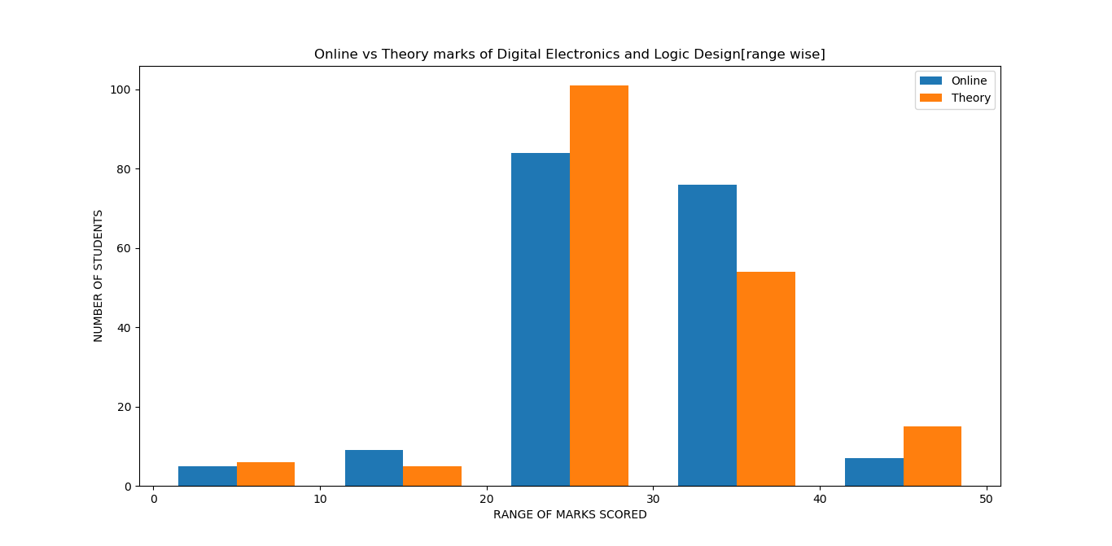
In the above graph we can clearly see that,most of students have secured marks in the range of 20-30 for both online as well as theory.Here, in some cases ranges the online marks beats the theory marks as well as viceversa,thus concluding that students ratio for marks scored in online as well as theory are equal.For the range 20-30 theory marks scored are more whereas for the range 30-40 online marks scored exceeds to that scored in theory.

Slide 22
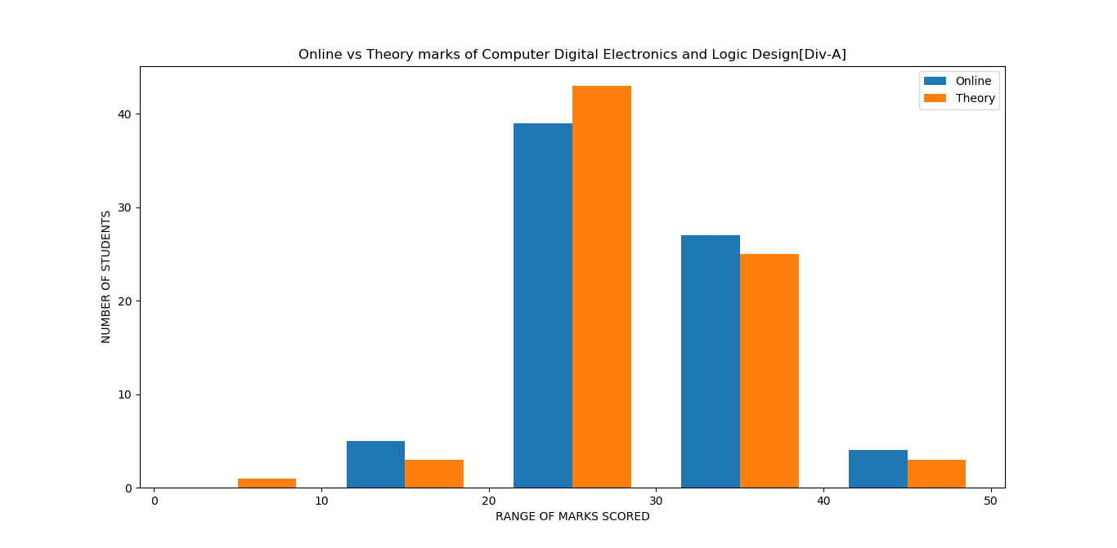
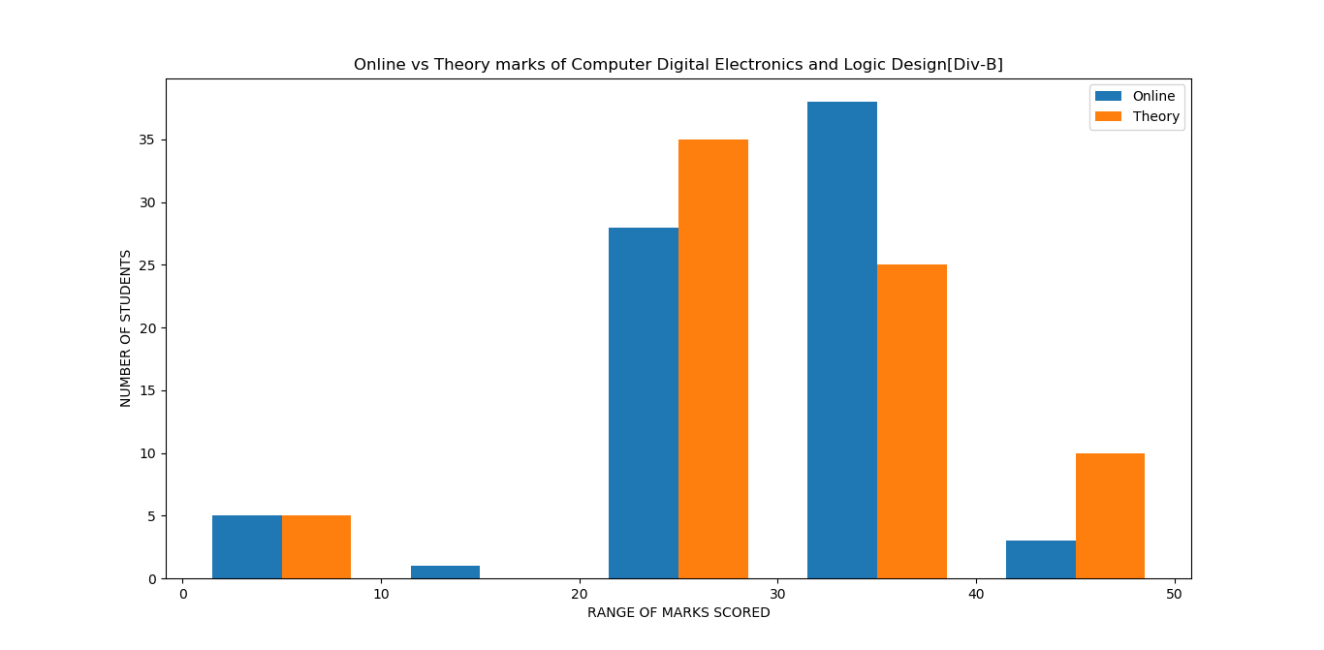
Online vs theory marks for DELD

Slide 23
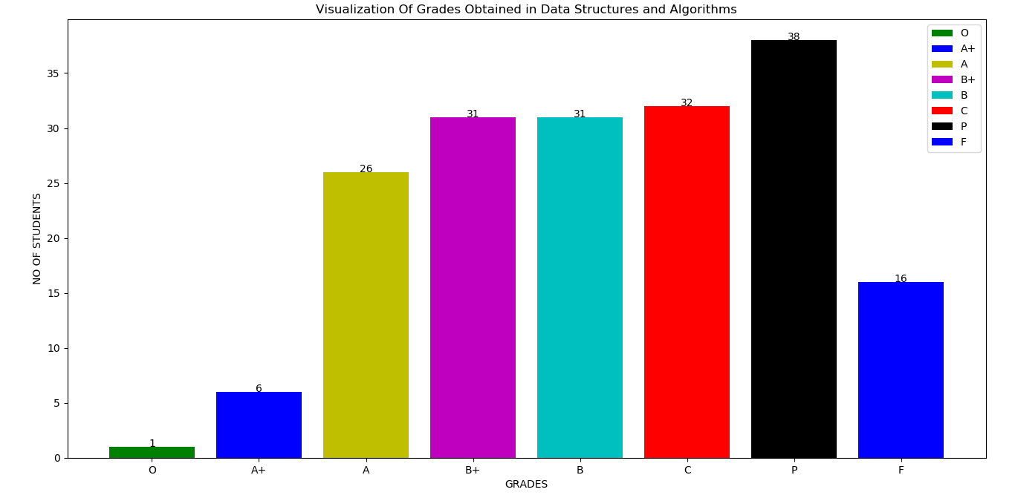
Visualization of grades for the subject DSA

Slide 24
In the above given graph we can clearly see
The number of students getting P grade( i.e.in the range of ) is the most compared to others.
The number of students securing A,B+,B,C grades are nearly equal(i.e. 26,31,31,32 respectively)
Students securing B+ and B grades are same
6 students have secured an A+ grade
Only 1 student have secured O grade(i.e above ).
26 students couldn’t clear this subject in the second attempt.

Slide 25
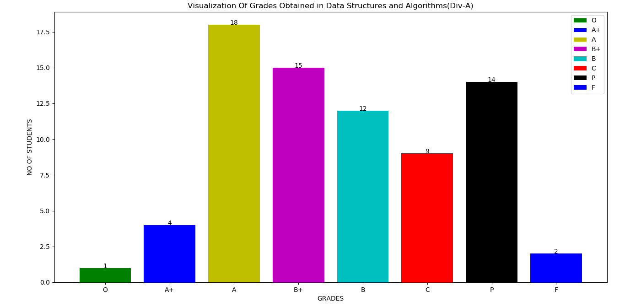
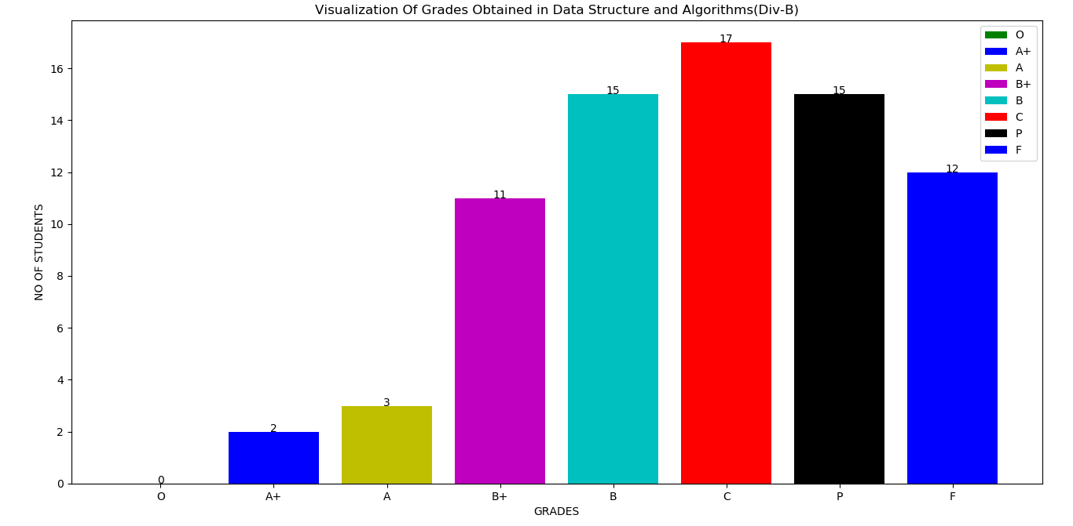
Visualization of grades for the subject DSA(div A)
Visualization of grades for the subject DSA(div B)

Slide 26
DIV-A
From the graph we can clearly see that,only 2 students could secure an O grade,whereas 4 students have secured A+ grade.2 students coudnt clear this subject in the second attempt from div A. Students securing A grade are 18 which is the highest.The number of students securing B+ and P grade are nearly equal.
DIV-B
From the graph we can clearly see that,no one could secure an O grade,whereas 2,3 students have secured A+ and A grade resp.11 students have got B+ grade.12 students could not clear this subject in the second attempt. The number of students securing B and P grade are equal(i.e.15 each). 17 students have got C grade which is the highest

Slide 27
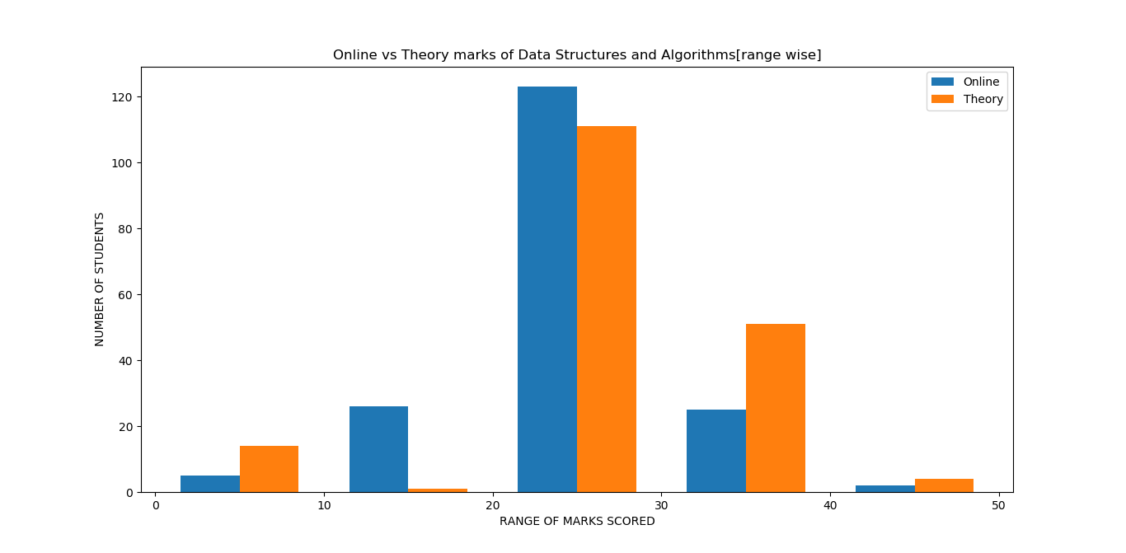
In the above graph we can clearly see that,most of students have secured marks in the range of 20-30 for both online as well as theory.Students securing marks in the range of 40-50 are the least for online whereas for the theory the range 20-30 has the least score.Here, in some cases ranges the online marks beats the theory marks as well as viceversa,thus concluding that students ratio for marks scored in online as well as theory are equal

Slide 28
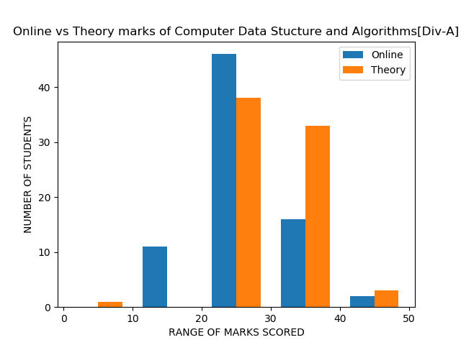
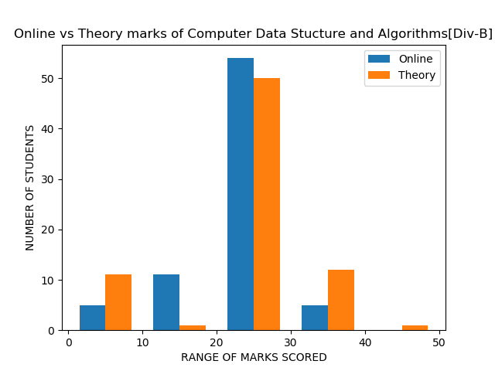
Online vs theory marks for DSA

Slide 29
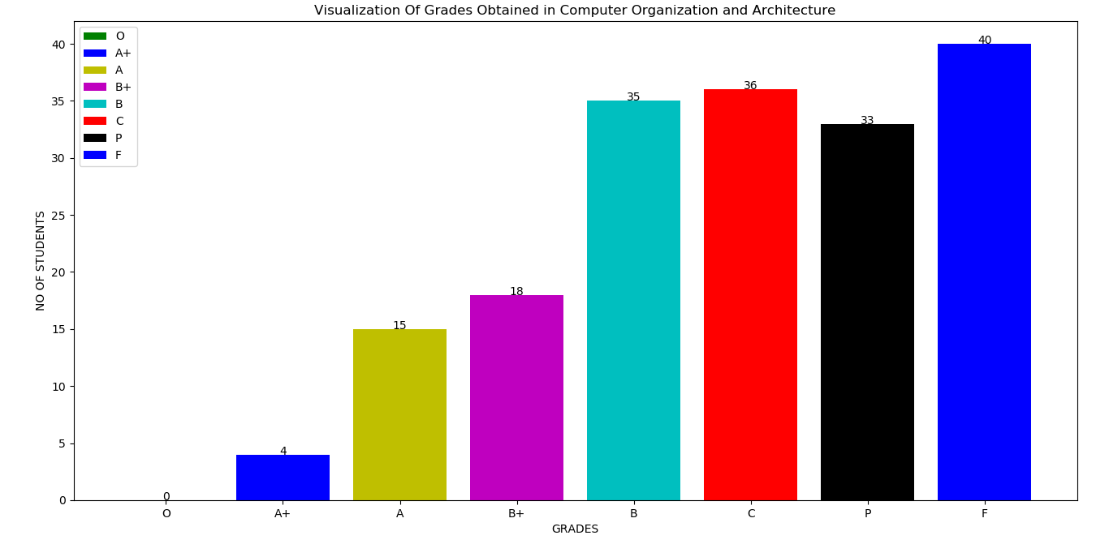
.
3 Visualization of grades for the subject COA

Slide 30
In the above given graph we can clearly see
The number of students getting B and C grade are nearly equal.
The ratio of latter grades are lot higher(the scoring in this subject is less).
The students are clearing this subject on average.
No one could secure an O grade(i.e above ).
40 students couldn’t clear this subject in the second attempt
.
The rate of failure is high for COA(i.e-students have a hard time understanding theory subjects).
8.The students getting an A+ grade are 4.

Slide 31
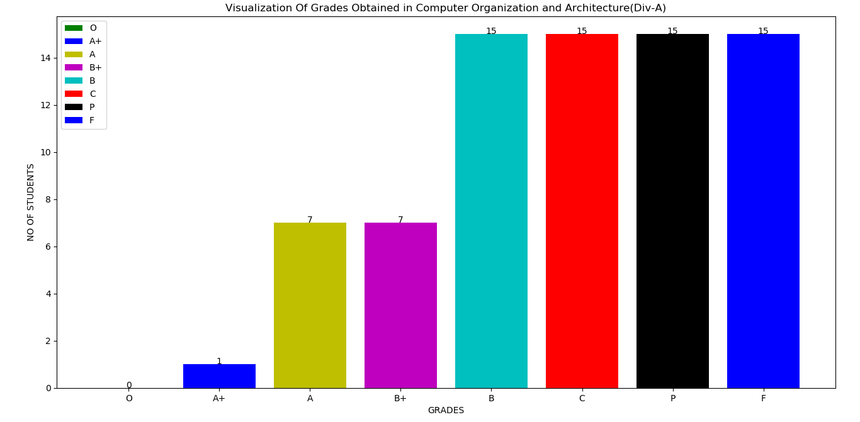
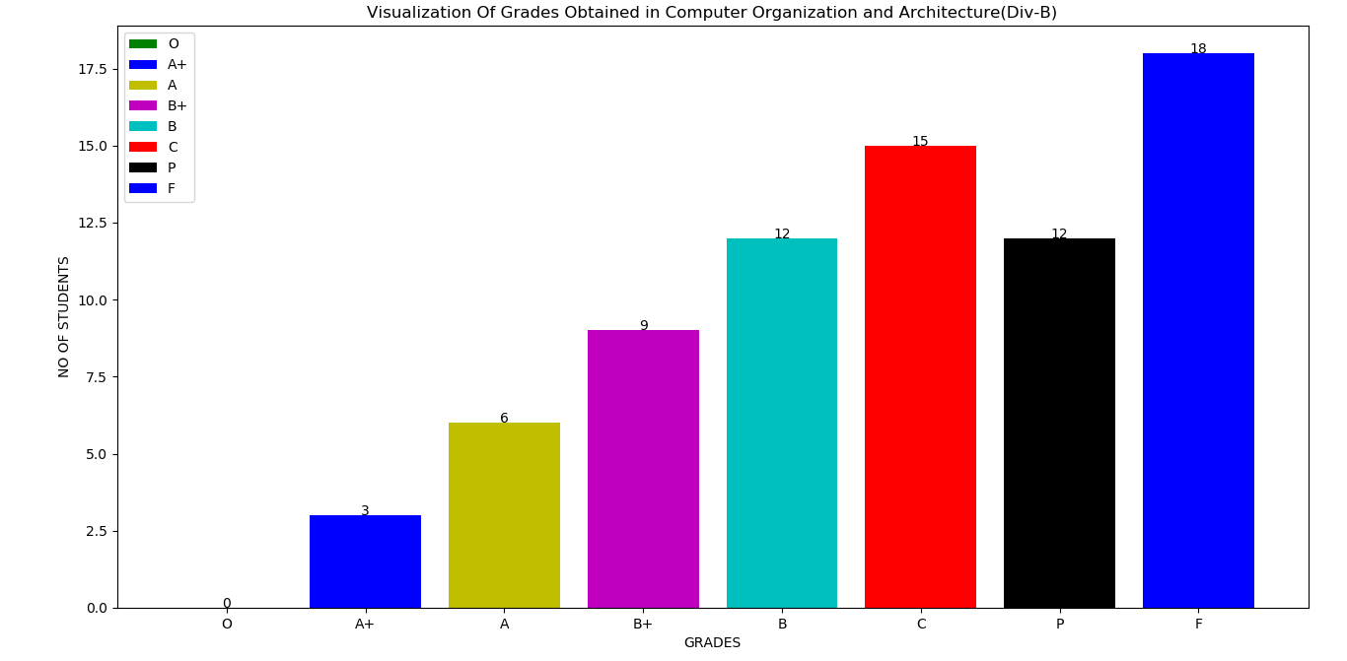
Visualization of grades for the subject COA(div A)
Visualization of grades for the subject COA(div B)

Slide 32
DIV-A
From the graph we can clearly see that,no one could secure an O grade,whereas only 1 student have secured A+ grade.The number of students securing B+ and A grade are equal(i.e.7 each), whereas remaining grades each have same number of students securing them(i.e.15 each).
DIV-B
From the graph we can clearly see that,no one could secure an O grade,whereas 3 students have secured A+ grade.9 students have got B+ grade.18 students could not clear this subject in the second attempt which is the highest.15 students have got C grade which is the second highest

Slide 33
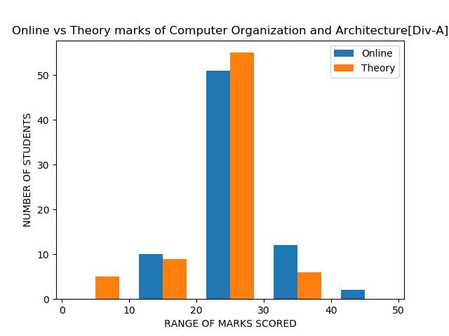
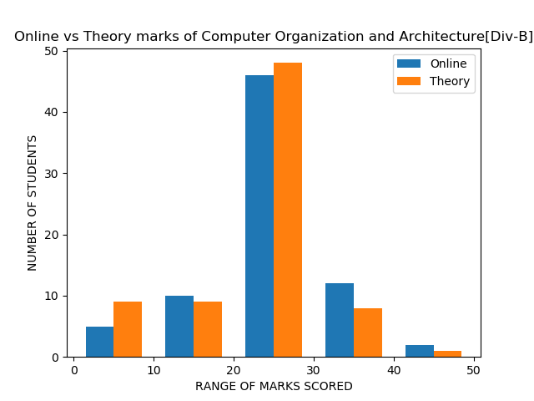
Online vs theory marks for COA

Slide 34
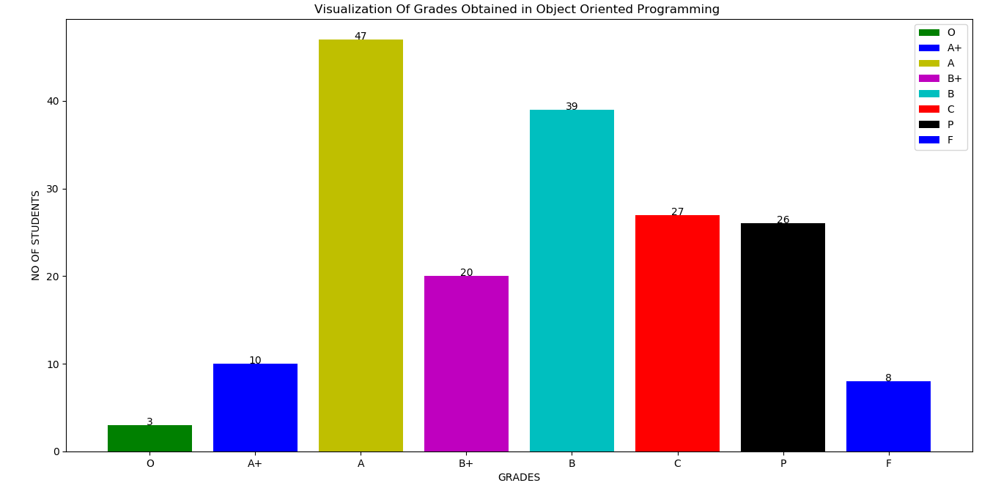
Visualization of grades for the subject OOP

Slide 35
In the above given graph we can clearly see
The number of students getting A grade( i.e.in the range of ) is the most compared to others.
The number of students securing C and P grades are nearly equal(i.e. 27,26 respectively)
Students securing B grade are 32 which is the second highest.
20 students have secured an A+ grade(i.e. above )
Only 3 students have secured O grade(i.e above ).
8 students couldn’t clear this subject in the second attempt.

Slide 36
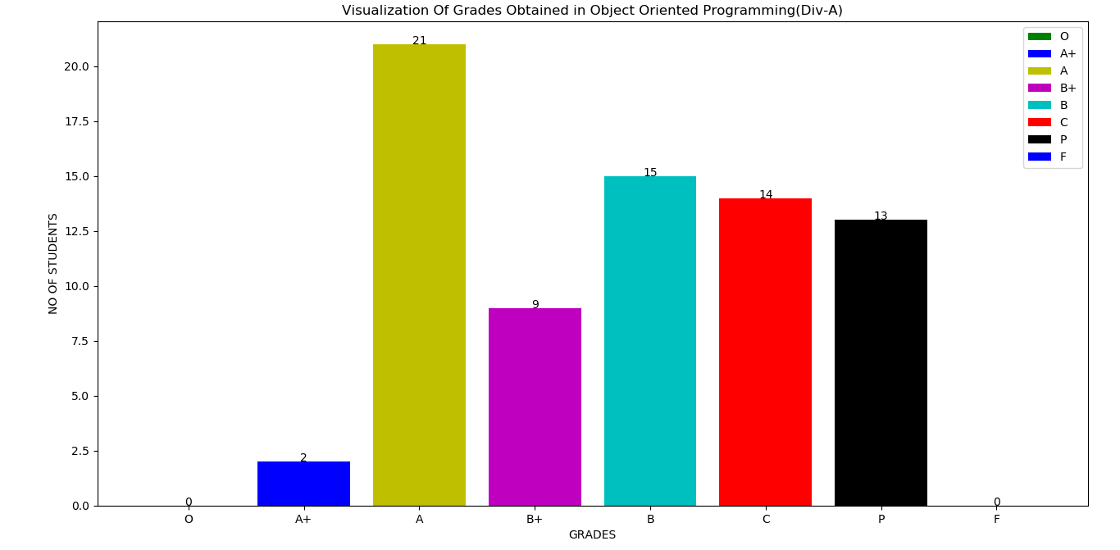
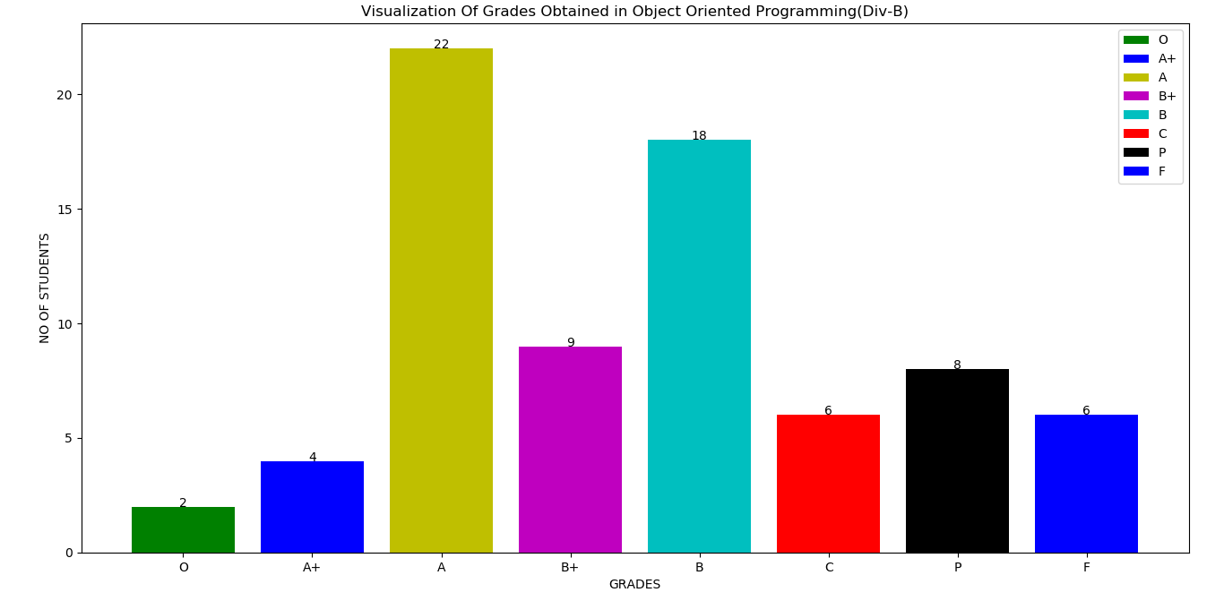
Visualization of grades for the subject OOP(div A)
Visualization of grades for the subject OOP(div B)

Slide 37
DIV-A
From the graph we can clearly see that,no one could secure an O grade,whereas only 2 students have secured A+ grade. Students securing A grade are 18 which is the highest.The best part is all students from div A have cleared this subject . Students securing A grade are 21 which is the highest
DIV-B
From the graph we can clearly see that,only 2,4 students could secure an O and A+ grade resp,whereas 22 students have secured A grade which is highest.9 students have got B+ grade. 6 students could not clear this subject in the second attempt.18 students have got B grade which is the second highest

Slide 38
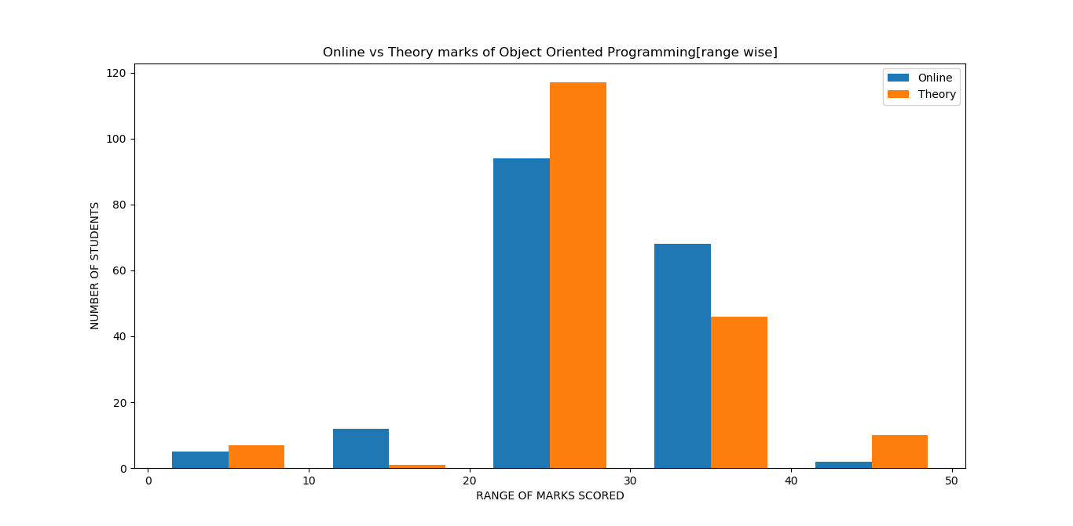
In the above graph we can clearly see that,most of students have secured marks in the range of 20-30 for both online as well as theory.Students securing marks in the range of 40-50 are the least for online whereas for the theory the range 20-30 has the least score.This graph is somewhat similar to that of DSA concluding that marks for both subject scored are similar to a lot extent.

Slide 39
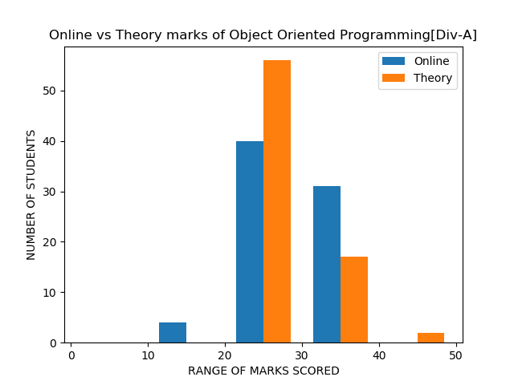
Online vs theory marks for OOP

Slide 40
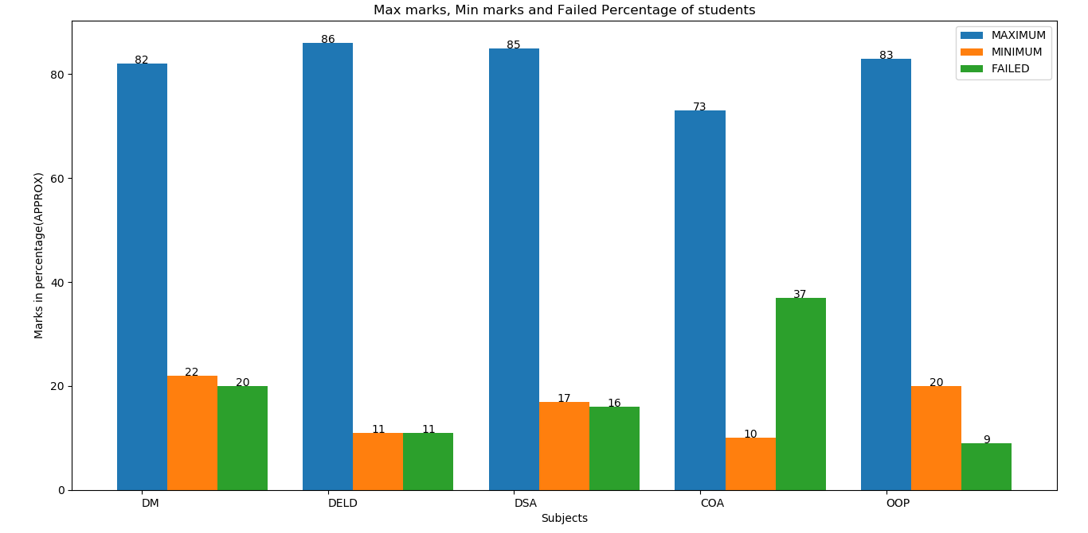

Slide 41
From the above graph we come to know that,
1]Maximum and minimum marks scored in DM are 82 and 22 resp while 20 students could not
2] Maximum and minimum marks scored in DELD are 86 and 12 resp while 11 students could not clear this subject.
3]Maximum and minimum marks scored in DSA are 85 and 17 resp while 11 students could not clear this subject.
4] Maximum and minimum marks scored in COA are 73 and 10 resp while 17 students could not clear this subject.
5] Maximum and minimum marks scored in OOP are 83 and 20 resp while 9 students could not clear this subject.

Slide 42
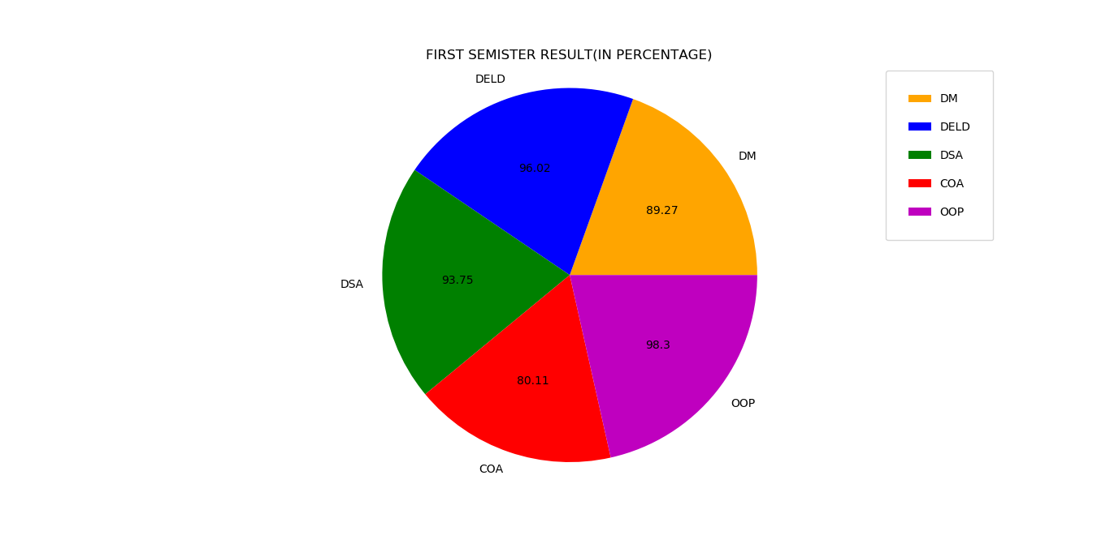
FIRST SEMESTER RESULT

Slide 43
From the above pie-chart we can see that DM having 89.27% result ,DELD having 85.64% result DSA having 93.75%result ,COA having 80.11% result and OOP having 98.30% result .OOP has the highest result and COA has the lowest result.

Slide 44
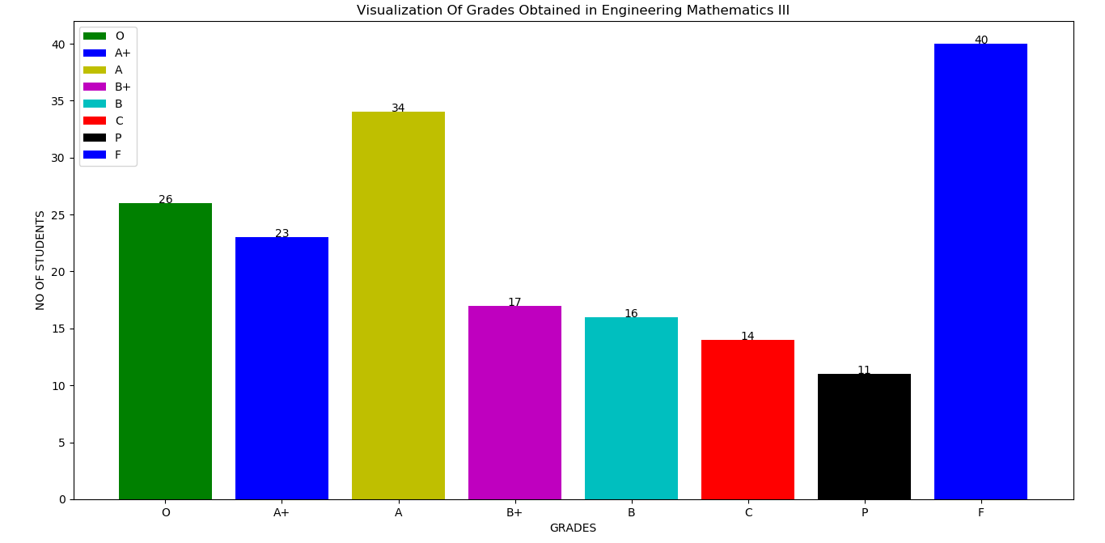
Visualization of grades for the subject M3

Slide 45
In the above given graph we can clearly see
The failure percentage is the most (i.e.40 students coudnt clear this subject)
Students securing A grade are 34 which is the second highest.
23 students have secured an A+ grade(i.e. above )
The students getting an O grade is the most compared to other subjects(i.e. Scoring is easy in mathematical subject.)
The result to contradictory to the result of COA .
The number of students securing B and B+grades are nearly equal(i.e. 17,16 respectively)

Slide 46
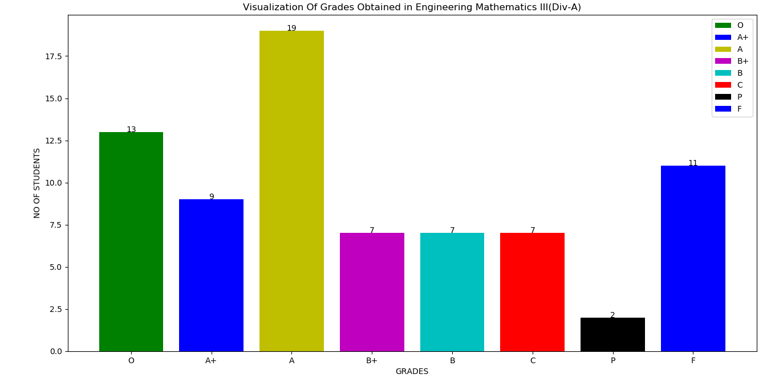
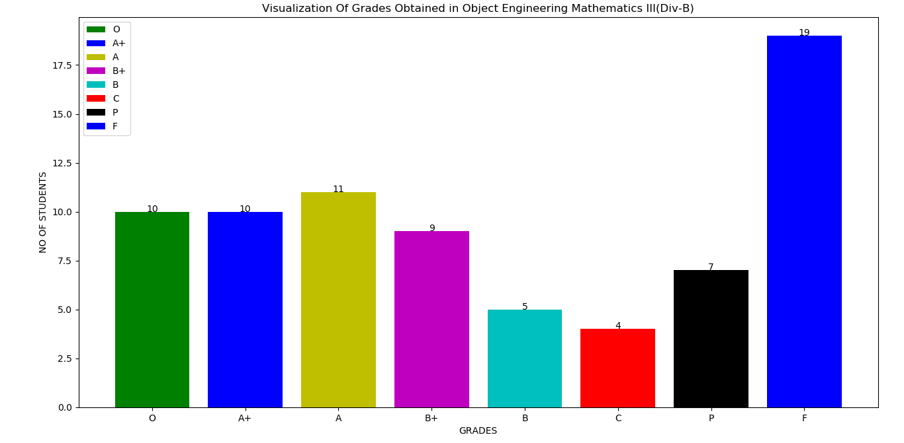
Visualization of grades for the subject M3 (div A)
Visualization of grades for the subject M3(div B)

Slide 47
DIV-A
From the graph we can clearly see that this subject has the highest passing rate,whereas only 2 students have secured P grade. Students securing A grade are 19 which is the highest.11 students couldn’t clear this subject . Students securing B+,B,C grades are same.
DIV-B
From the graph we can clearly see that,10 students have secure an O and A+ grade each,whereas 11 students have secured A grade which is highest.9 students have got B+ grade. 19 students could not clear this subject.Scoring percentage is high here.

Slide 48
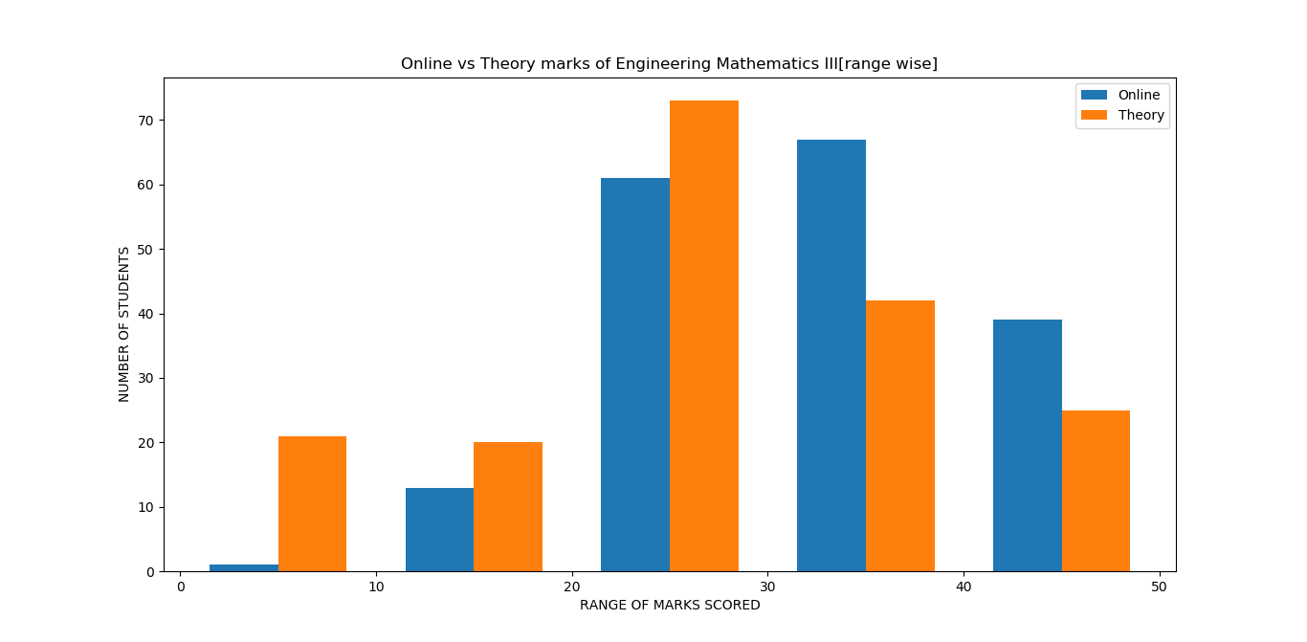
Online vs theory marks for M3
In the above graph,for the range 20-30 and 30-40 firstly the theory marks exceeds the online marks whereas it is the opposite for the next range concluding that both the ranges equally balance each other.Students securing marks in the range of 0-10 are the least for both online as well as theory.

Slide 49
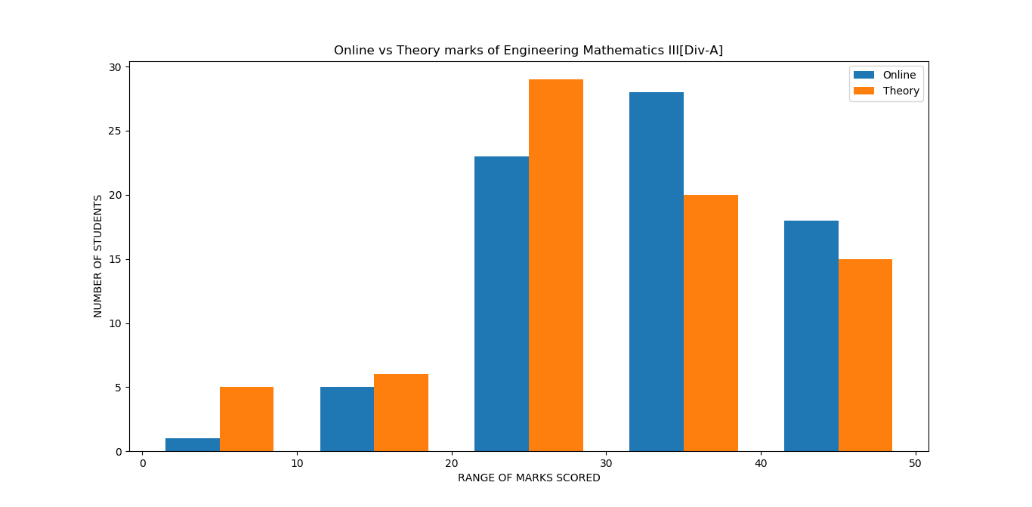
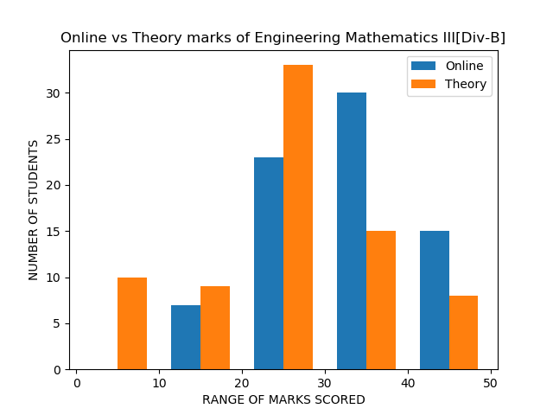
Online vs theory marks for M3

Slide 50
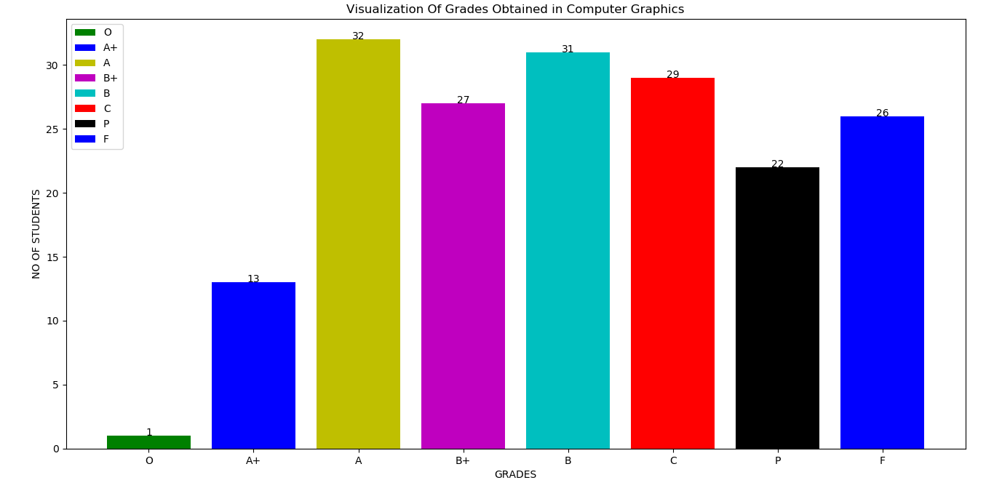
Visualization of grades for the subject CG

Slide 51
In the above given graph we can clearly see
26 students couldn’t clear this subject
Students securing A grade are 32 which is the highest.
13 students have secured an A+ grade(i.e. above )
Only 1 student could secured an O grade
The number of students securing B and A grades are nearly equal
The number of students securing B+ and C grades are nearly equal

Slide 52
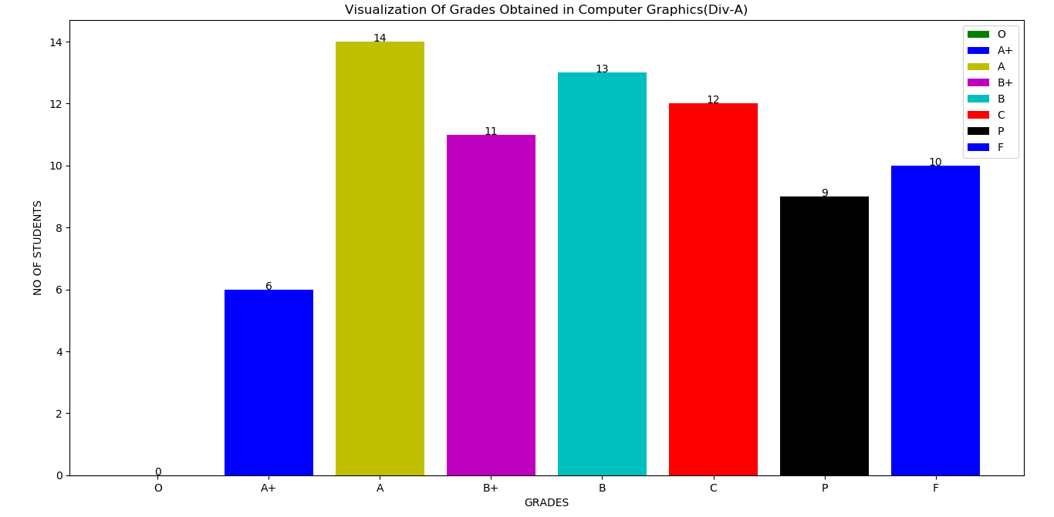
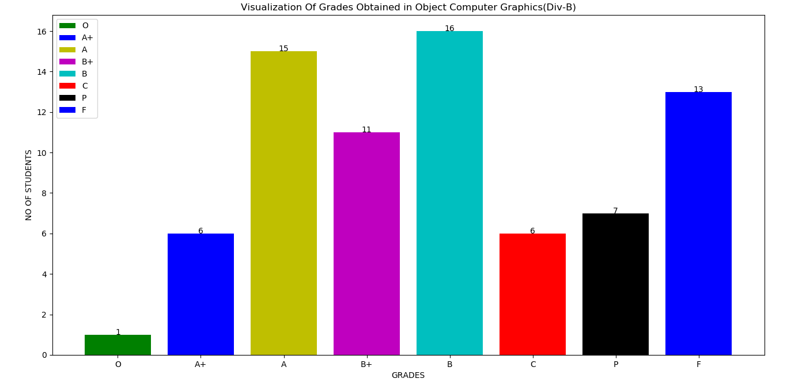
Visualization of grades for the subject CG (div A)
Visualization of grades for the subject CG(div B)

Slide 53
DIV-A
From the graph we can clearly see that,no one could secure an O grade,whereas 6 students have secured A+ grade. 10 students couldn’t clear this subject. Students securing A grade are 14 which is the highest. secure an O grade,whereas 4 students have secured A+ grade.2 students couldnt clear this subject in the second attempt from div A. Students securing A grade are 18 which is the highest.The number of students securing A,B+ ,B and C grade are in same range(14,11,13,12 respectively).
DIV-B
From the graph we can clearly see that,only 1 student could secure an O grade,whereas 6 students have secured A+ grade.15 students have got A grade.13 students could not clear this subject.18 students have got B grade which is the highest.

Slide 54
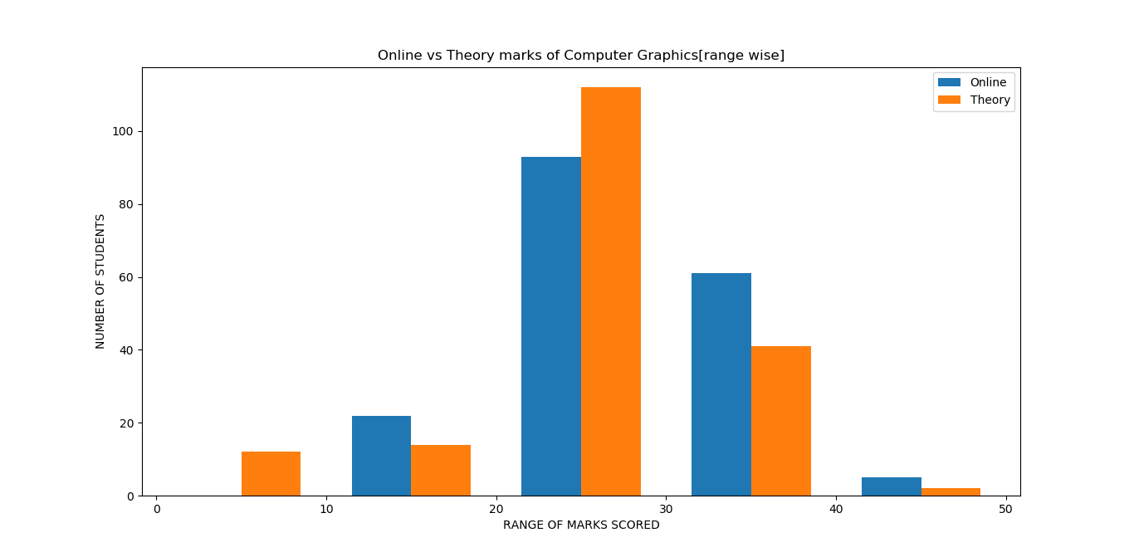
In the above graph,for the range 20-30 and 30-40 firstly the theory marks exceeds the online marks whereas it is the opposite for the next range concluding that both the ranges equally balance each other.Students securing marks in the range of 0-10 are the least for online whereas least in the range of 40-50 for theory.

Slide 55
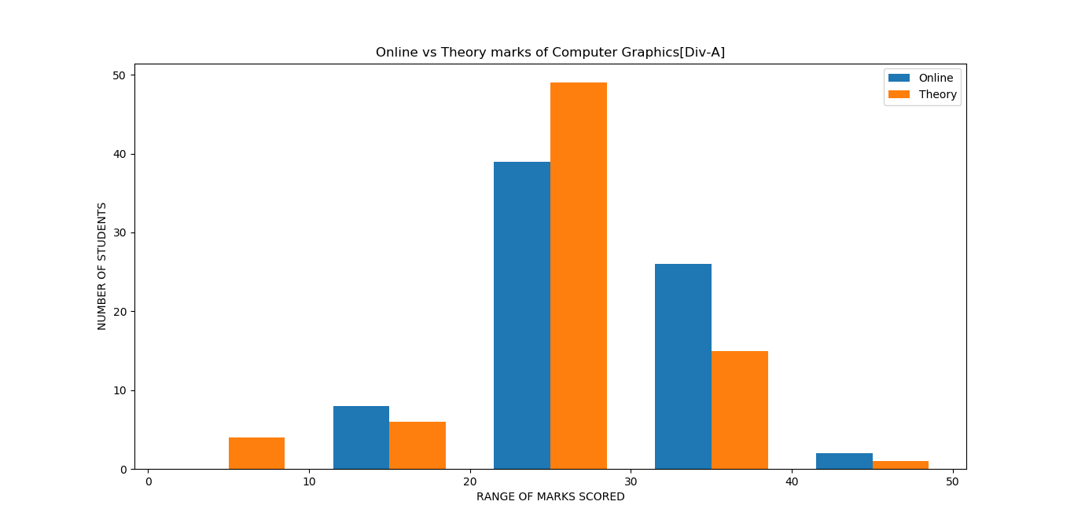
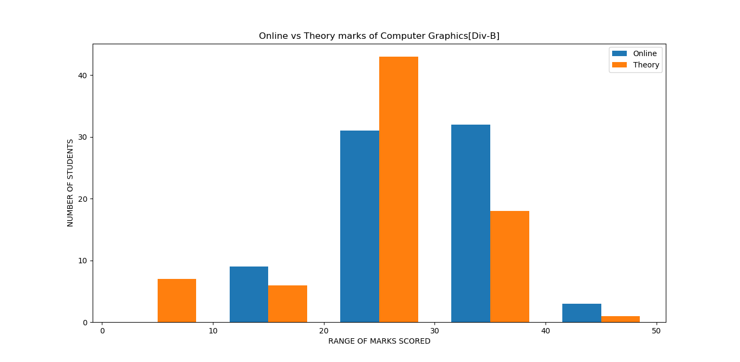
Online vs theory marks for CG

Slide 56
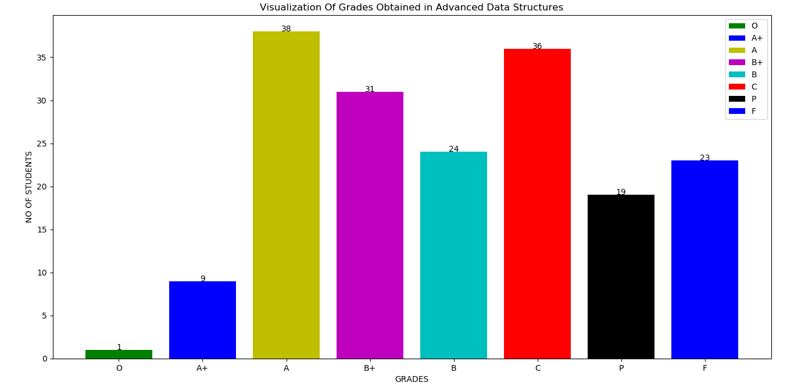
Visualization of grades for the subject ADS

Slide 57
In the above given graph we can clearly see
23 students coudnt clear this subject
Students securing A grade are 38 which is the highest.
Students securing C grade are 36 which is the second highest.
Only 9 students have secured an A+ grade(i.e. above )
Only 1 student could secured an O grade

Slide 58
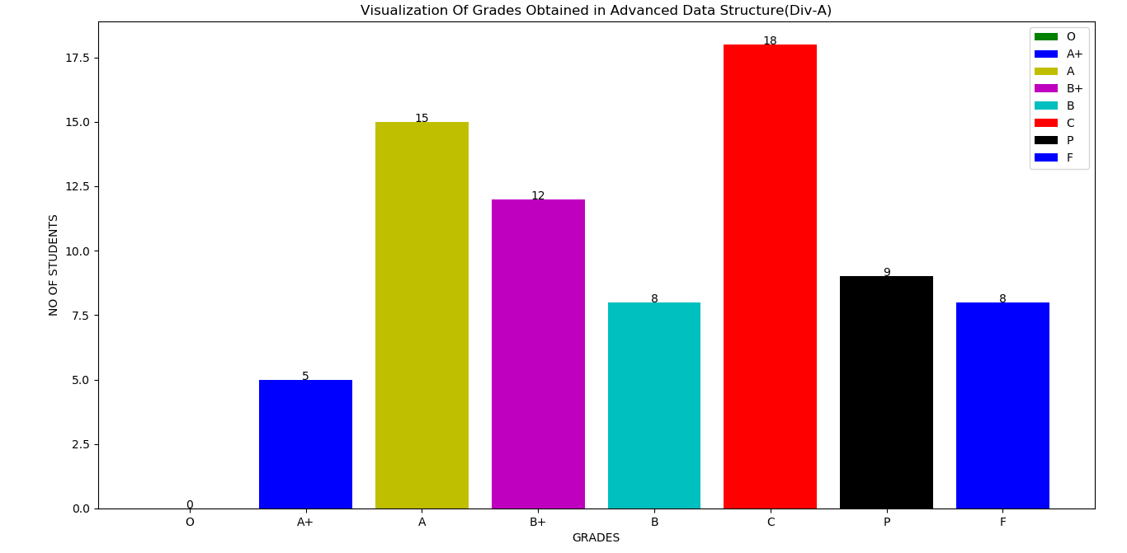
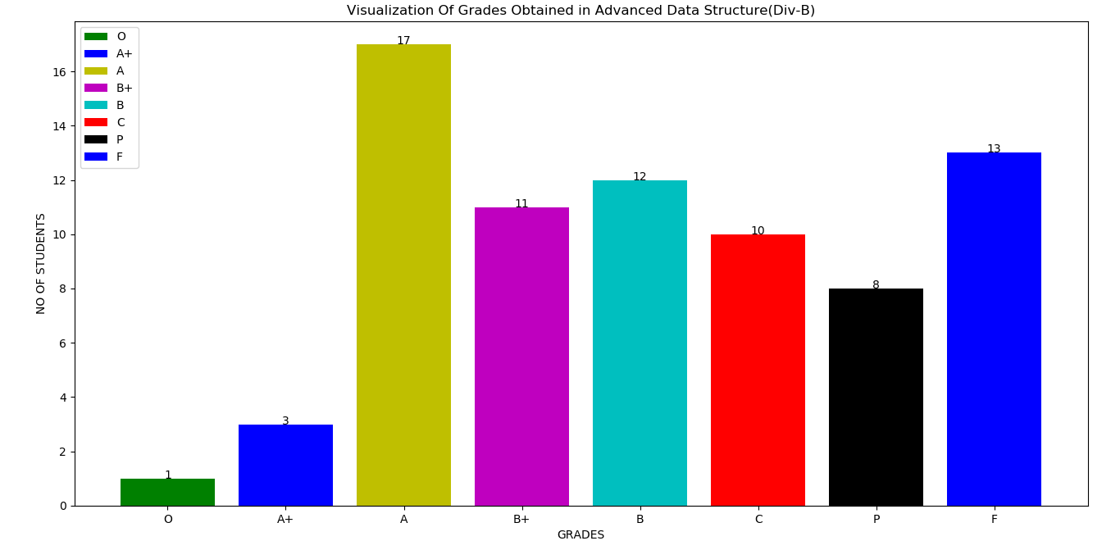
Visualization of grades for the subject ADS (div A)
Visualization of grades for the subject ADS(div B)

Slide 59
DIV-A
From the graph we can clearly see that,no one could secure an O grade,whereas 5 students have secured A+ grade. . Students securing C grade are 18 which is the highest. Students securing A grade are 15 which is the second highest.8 students coudnt clear this subject in the from div A.
DIV-B
From the graph we can clearly see that,only 1 student could secure an O grade,whereas 3 students have secured A+ grade.17 students have got A grade which is the highest.13 students could not clear this subject.Students getting B+,B, and C grade are nearly equal(i.e.11,12,10 resp).

Slide 60
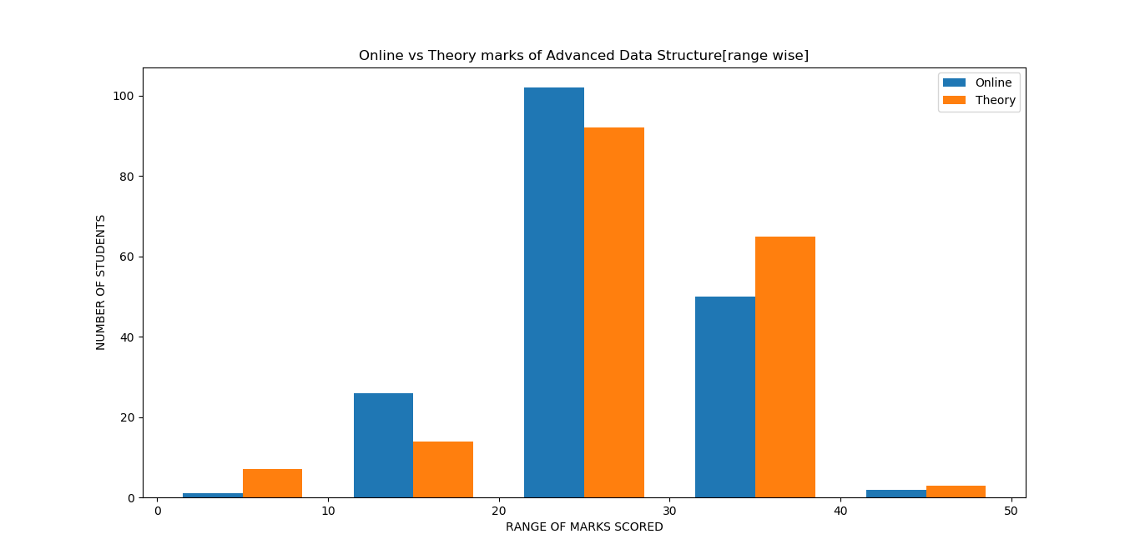
In the above graph we can clearly see that,most of students have secured marks in the range of 20-30 for both online as well as theory.Students securing marks in the range of 40-50 are the least for online whereas for the theory the range 20-30 has the least score.Here, in some cases ranges the online marks beats the theory marks as well as viceversa,thus concluding that students ratio for marks scored in online as well as theory are somewhat equal

Slide 61
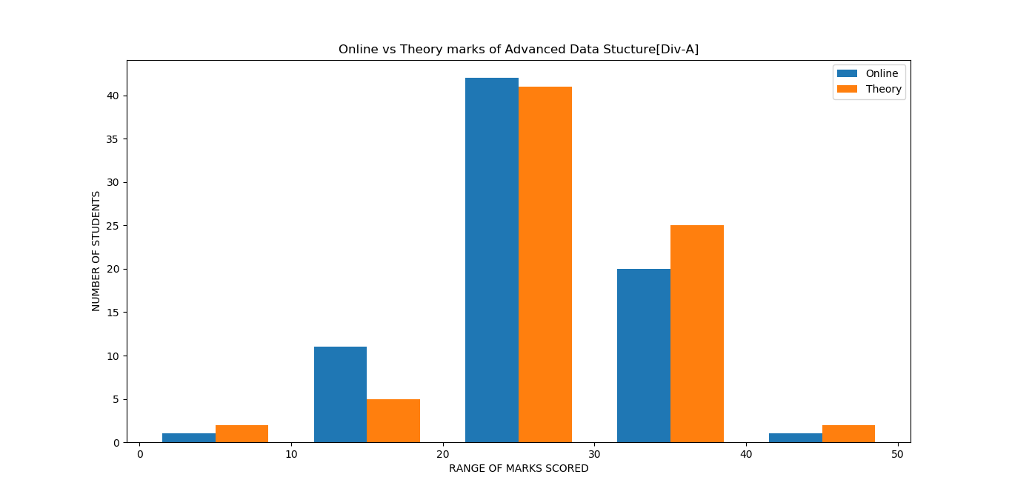
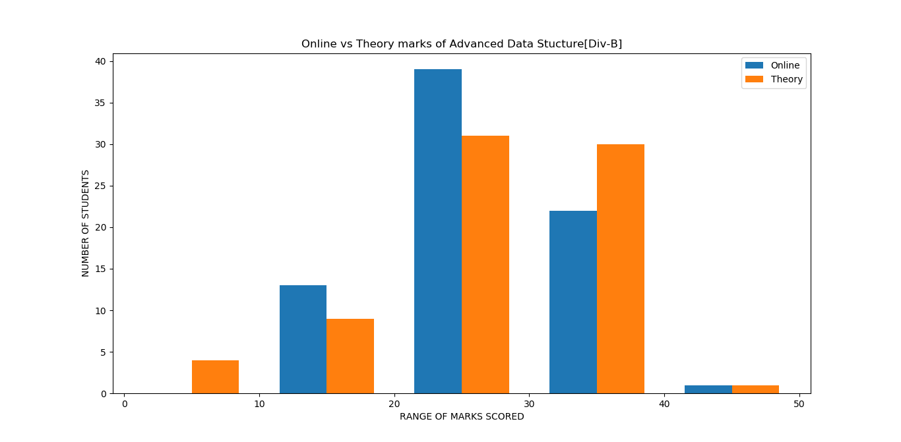
Online vs theory marks for ADS

Slide 62

Visualization of grades for the subject MP

Slide 63
In the above given graph we can clearly see
The failure result is the most (i.e.40 students coudnt clear this subject)
The failure result is same like M3
Students securing C grade are 37 which is the second highest.
Only 5 students have secured an A+ grade(i.e. above )
The students getting an O grade is the most compared to other subjects(i.e. Scoring is easy in mathematical subject.)
4 studens have secured an O grade
The number of students securing A and B+grades are nearly equal(i.e. 22,21 respectively)

Slide 64


1e Visualization of grades for the subject MP (div A)
Visualization of grades for the subject MP(div B)

Slide 65
DIV-A
From the graph we can clearly see that,only 1student could secure an O grade,whereas 2 students have secured A+ grade . Students securing C grade are 18 which is the second highest. Students securing A, B+ and B grade are 3 ,6 and 8 respectively.22 students coudnt clear this subject in the from div A.
DIV-B
From the graph we can clearly see that,only 2 students could secure an O grade,whereas 3 students have secured A+ grade.18 students have got A grade which is the highest.11 students could not clear this subject.

Slide 66

In the above graph we can clearly see that,most of students have secured marks in the range of 20-30 for both online as well as theory.Students securing marks in the range of 40-50 are the least for theory whereas for online the range 0-10 is applicable as there are no figures of marks .Here, in some cases ranges the online marks beats the theory marks as well as viceversa,thus concluding that students ratio for marks scored in online as well as theory are somewhat equal

Slide 67


Online vs theory marks for MP

Slide 68

Visualization of grades for the subject PPL

Slide 69
In the above given graph we can clearly see
The failure percentage is the most (i.e.38 students coudnt clear this subject)
Students securing A grade are 34 which is the second highest.
Only 3 students have secured an A+ grade(i.e. above )
No one could secure an O grade
The number of students securing B and C grades are nearly equal(i.e. 31,32 respectively)
The number of students securing A and B+ grades are nearly equal(i.e.26,24 respectively)

Slide 70


Visualization of grades for the subject PPL (div A)
Visualization of grades for the subject PPL(div B)

Slide 71
DIV-A
From the graph we can clearly see that,no one could secure an O as well as A+ grade,whereas only 6 students have secured B+ grade.The number of students securing B and C grade are nearly equal(i.e.17 and 16 respectively ),10 students could not clear this subject.
DIV-A
From the graph we can clearly see that,no one could secure an O grade,whereas only 2 students have secured A+ grade.10 students have got A grade. 23 students could not clear this subject.12 students have got B+ grade.

Slide 72

In the above graph we can clearly see that,most of students have secured marks in the range of 20-30 for both online as well as theory.Students securing marks in the range of 40-50 are the least for both online and theory.For the range 30-40 online as well as theory marks are equal

Slide 73


0nline vs theory marks for PPL

Slide 74


Slide 75
From the above graph we come to know that,
1]Maximum and minimum marks scored in EM3 are 99 and 8 resp while 31 students could not clear this subject.
2] Maximum and minimum marks scored in CG are 81 and 16 resp while 20 students could not clear this subject.
3]Maximum and minimum marks scored in ADS are 85 and 17 resp while 29 students could not clear this subject.
4] Maximum and minimum marks scored in MP are 90 and 11 resp while 38 students could not clear this subject.
5] Maximum and minimum marks scored in PPL are 78 and 8 resp while 32 students could not clear this subject.

Slide 76

SECOND SEMESTER RESULT

Slide 77
From the above pie-chart we can see that M3 having 77.9% result ,CG having 85.64% result ADS having 87.29%result , MP having 80.11% result and PPL having 77.9% result .ADS has the highest result .MP and M3 having same result.

Slide 78
Normal Linear Regression Graph for Prediction
Linear regression is the process of fitting a linear equation to set of sample data in order to predict the output. Here we generated the linear regression for predicting the credit points from the total (i.e. online and theory) marks. We used PYTHON for plotting the regression graph.

Slide 79






Slide 80






Slide 81
CONCLUSION
From this mini-project we came to know about the result of each and every subject of the second year (2017-18) [Computer department]. From the overall analysis we have concluded the performance of students in each subject and its respective faculty. By analysing the result, we came to the conclusion that 2017-18 result is better than the previous years.
The result we got is as follows:
Discrete Mathematics - 89.27%
Digital Electronics and Logic Design - 96.02%
Data Structure and Algorithms – 93.75%
Computer Organization and Architecture – 80.11%
Object Oriented Programming – 98.30%
Engineering Mathematics III – 77.9%
Computer Graphics – 85.64%
Advanced Data Structure – 87.29%
Microprocessor - 77.9%
Principles of Programming Language – 79.01%

Slide 82
In this year, students scored more marks in OOP subject i.e. 98.30%. EM III has the lowest result as compared to all other subjects. All the remaining subjects are having average result.
By comparing the online and theory marks of students, we came to know that online is easy to score. All students scored more marks in online as compared to theory. Because of this the overall result (pointer) of each student is increased.
According to our analysis, we can say that most of students scored marks in the range of 20-30 for both online and theory.
In DM the number of students getting C grade (i.e.in the range of 60-69) is the most as compared to other grades.
In DELD the number of students securing A+, A, B grades are nearly equal (i.e. 33, 36, 34 students respectively).
In DSA the number of students getting P grade is the most compared to others. The number of students securing A, B+, B, C grades are nearly equal (i.e. 26, 31, 31, 32 respectively).
In COA the no. of students getting B and C grade are nearly equal. 40 students gets failed in this subject.

Slide 83
In OOP the number of students getting A grade (i.e.in the range of 80-89) is the most compared to others.
In EM III the failure percentage is the most i.e. 40 students couldn’t cleared this subject. 26 students got O grade in EM III.
In CG, 26 students couldn’t clear this subject. 32 students got A grade.
In ADS 38 students secured A grade.
From this result we can say that students have to take more efforts to increase the overall result of computer department.
Both A and B division has the average performance in the last year.

